Slide 2
Objectives Overview
Describe the characteristics and uses of laptops, tablets, desktops, and all-in-ones
Describe the characteristics and types of servers
Differentiate among POS terminals, ATMs, and self-service kiosks
Describe cloud computing and identify its uses
Describe the characteristics and uses of smartphones, digital cameras, portable and digital media players, e-book readers, and wearable devices
See Page 108
for Detailed Objectives

Slide 3
Objectives Overview
Describe the characteristics of and ways to interact with game devices
Identify uses of embedded computers
Differentiate a port from a connector, identify various ports and connectors, and differentiate among Bluetooth, Wi-Fi, and NFC wireless device connections
Identify safeguards against hardware theft and vandalism and hardware failure
Discuss ways to prevent health-related injuries and disorders caused from technology use, and describe ways to design a workplace ergonomically
See Page 108
for Detailed Objectives

Slide 4
Computers and Mobile Devices
Types of computers and mobile devices include:
Laptops, tablets, and desktops
Servers and terminals
Smartphones, digital cameras, e-book readers, portable and digital media players and wearable devices
Game devices
Embedded computers
Page 108

Slide 5
Mobile Computers and Desktops
A mobile computer is a portable personal computer, designed so that a user easily can carry it from place to place
A personal computer (PC) is a mobile computer or desktop that can perform all of its input, processing, output, and storage activities by itself and is intended to be used by one person at a time
Page 108

Slide 6
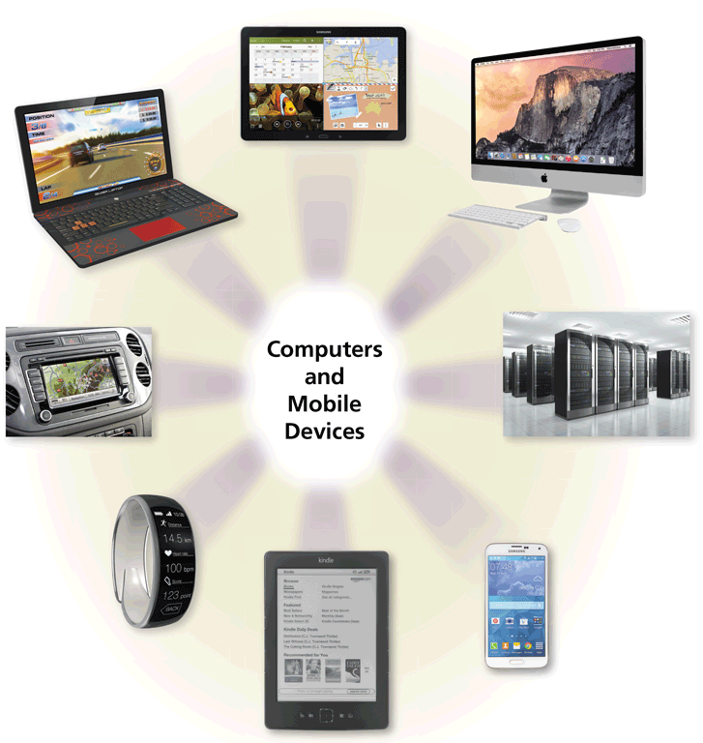
Mobile Computers and Desktops
Page 109
Figure 3-1

Slide 7
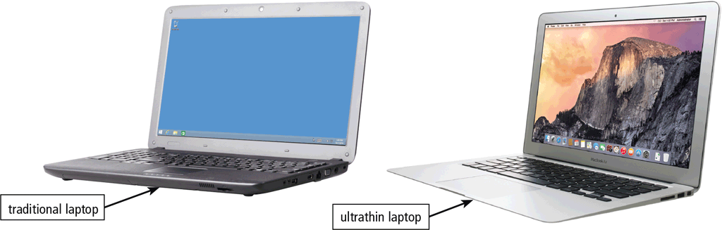
Mobile Computers and Desktops
A laptop, also called a notebook computer, is a thin, lightweight mobile computer with a screen in its lid and a keyboard in its base
Page 111
Figure 3-3

Slide 8
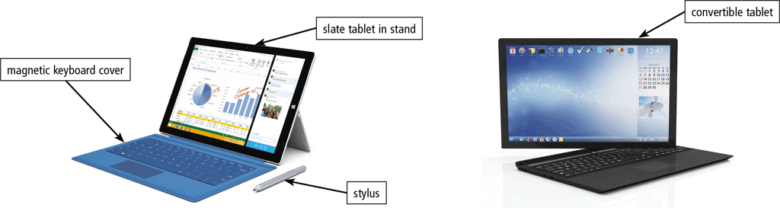
Mobile Computers and Desktops
A tablet is a thin, lighter-weight mobile computer that has a touch screen
Page 112
Figure 3-4

Slide 9
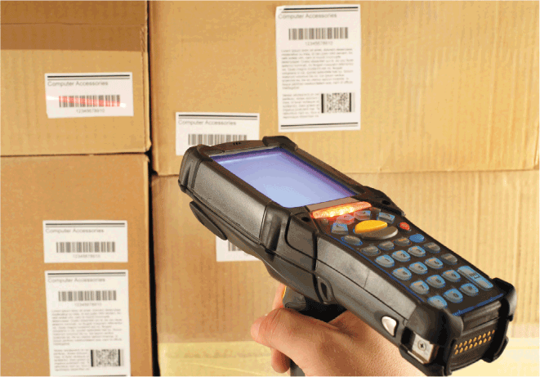
Mobile Computers and Desktops
A handheld computer is a computer small enough to fit in one hand
Page 112
Figure 3-6

Slide 10
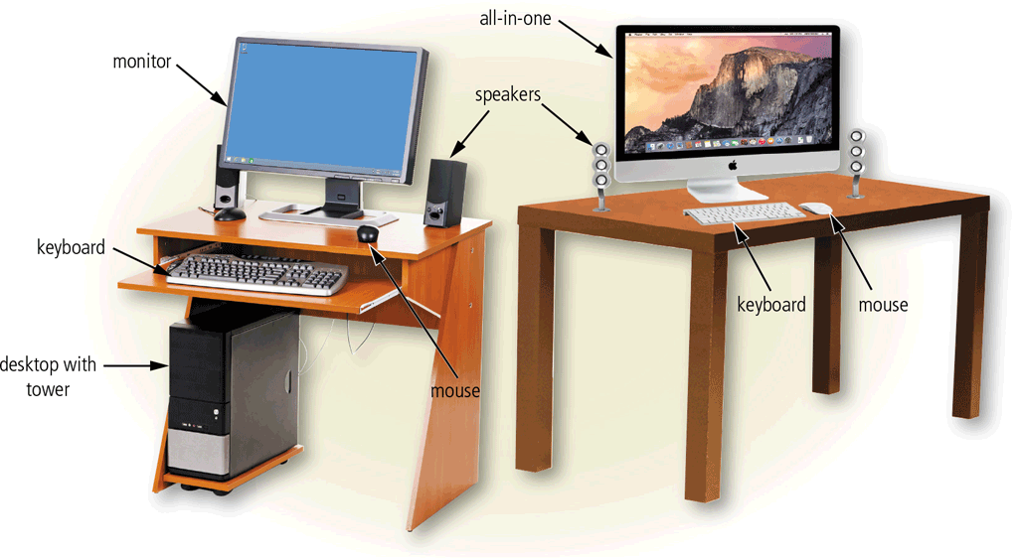
Mobile Computers and Desktops
A desktop, or desktop computer, is a personal computer designed to be in a stationary location, where all of its components fit on or under a desk or table
Page 114
Figure 3-7

Slide 11
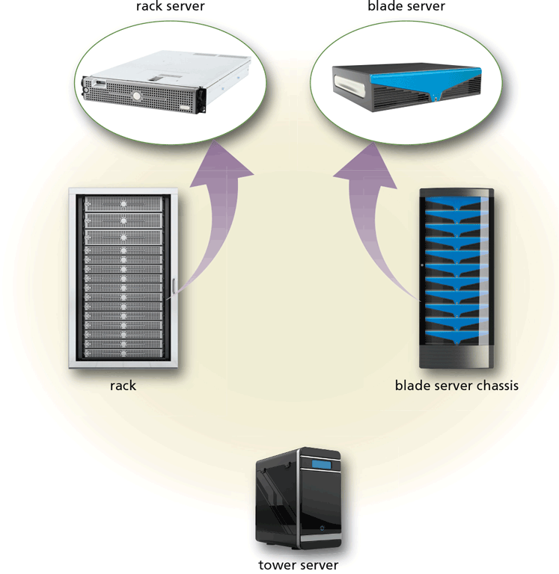
Servers
A server is a computer dedicated to providing one or more services to other computers or devices on a network
Rack server
Blade server
Tower server
Page 116
Figure 3-8

Slide 12
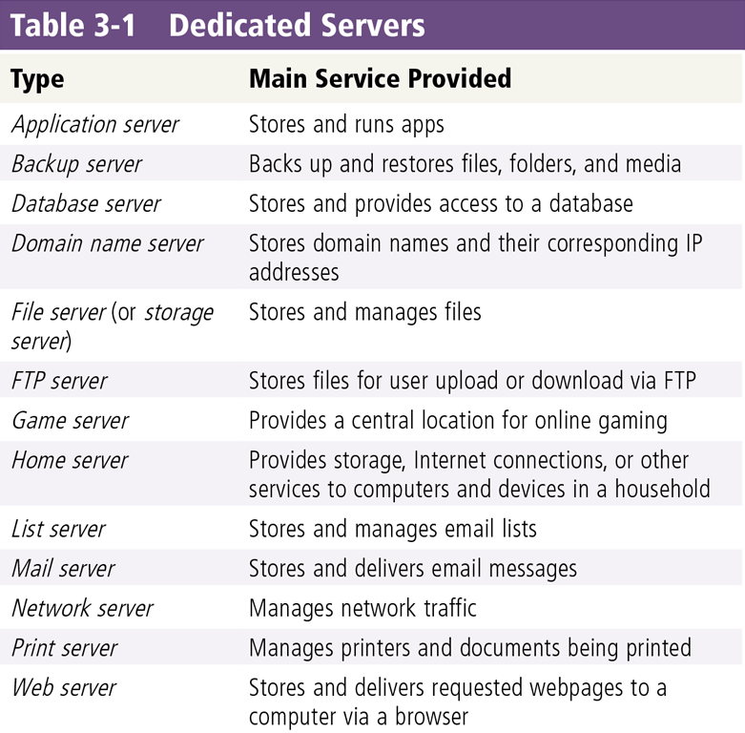
Servers
Page 116
Table 3-1

Slide 13
Servers
Virtualization is the practice of sharing or pooling computing resources, such as servers and storage devices
Server virtualization uses software to enable a physical server to emulate the hardware and computing capabilities of one or more servers, known as virtual servers
A server farm is a network of several servers together in a single location
Page 117

Slide 14
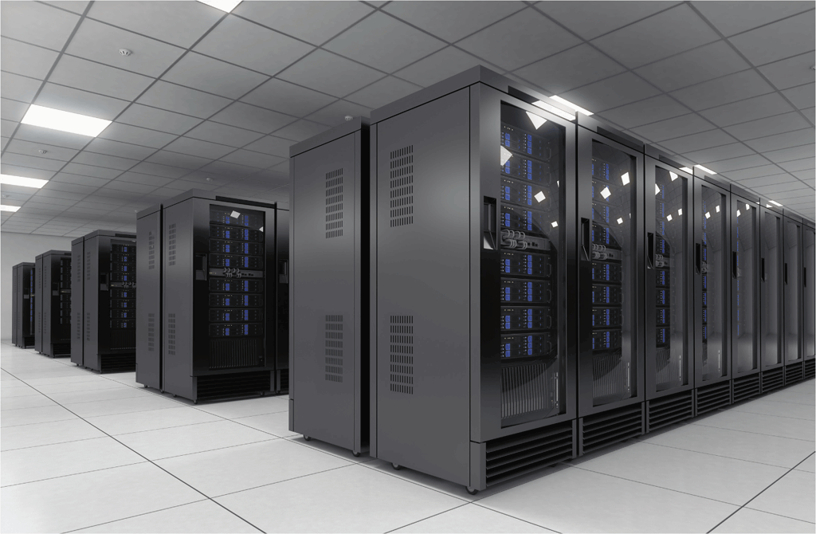
Servers
A mainframe is a large, expensive, powerful server that can handle hundreds or thousands of connected users simultaneously
Page 117
Figure 3-9

Slide 15
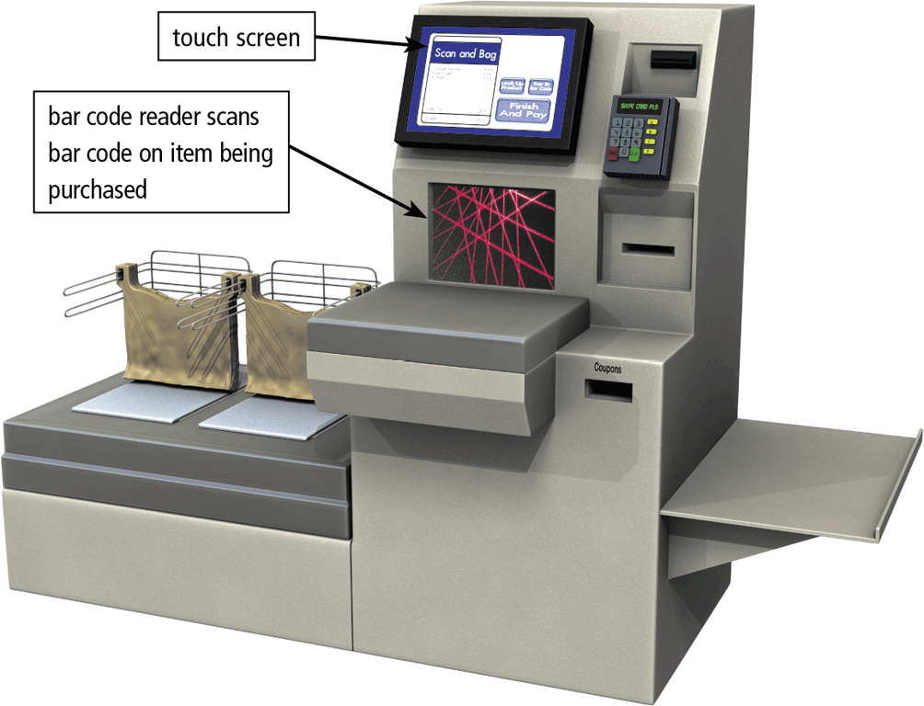
Terminals
A terminal is a computer, usually with limited processing power, that enables users to send data to and/or receive information from a server, or host computer
A thin client is a terminal that looks like a desktop but has limited capabilities and components
Most retail stores use a POS terminal to record purchases, process credit or debit cards, and update inventory
Pages 117 - 118
Figure 3-10

Slide 16
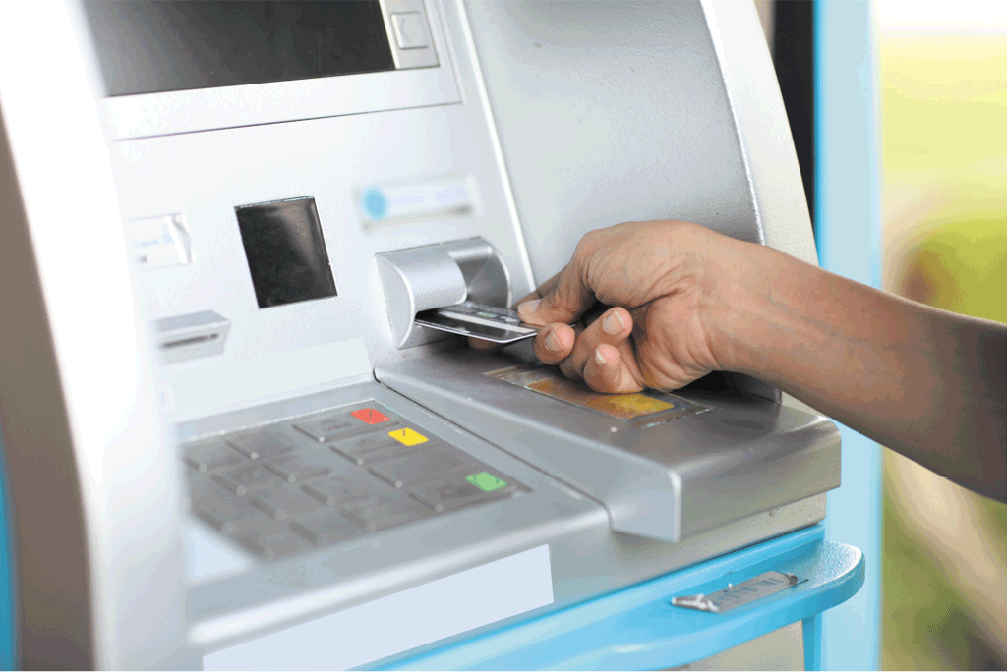
Terminals
An ATM (automated teller machine) is a self-service banking terminal that connects to a host computer through a network
Page 118
Figure 3-11

Slide 17
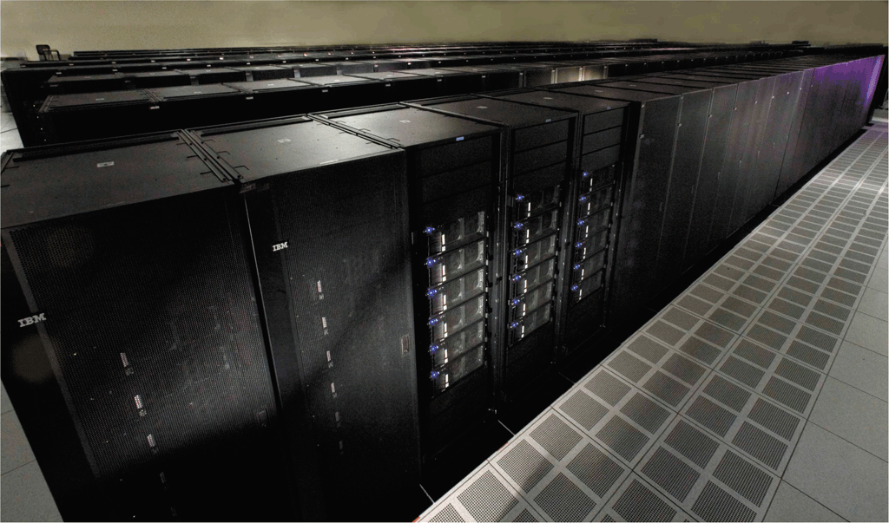
Supercomputers
A supercomputer is the fastest, most powerful computer – and the most expensive
Capable of processing many trillions of instructions in a single second
Page 120
Figure 3-13

Slide 18
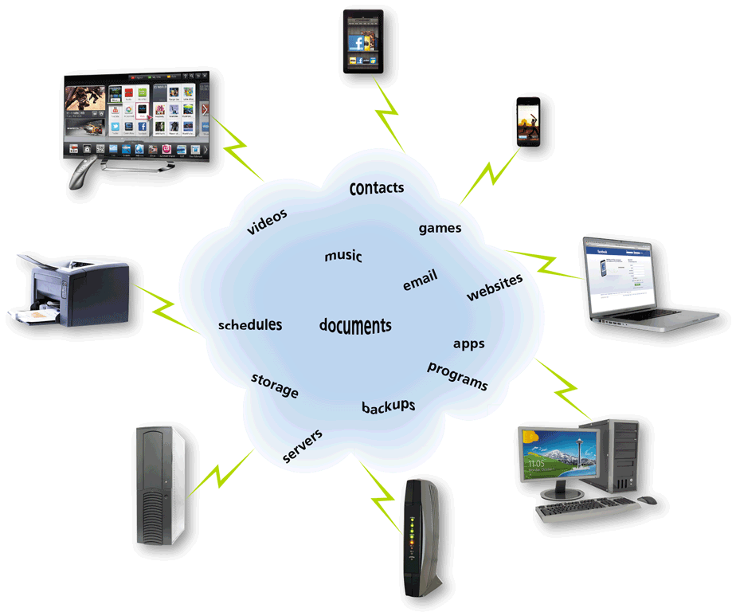
Cloud Computing
Cloud computing refers to an environment that provides resources and services accessed via the Internet
Page 121
Figure 3-14

Slide 19
Mobile Devices
A smartphone is an Internet-capable phone that usually also includes a calendar, an address book, a calculator, a notepad, games, browser, and numerous other apps
Many smartphones have touch screens. Instead of or in addition to an on-screen keyboard, some have a built-in mini keyboard on the front of the phone or a keyboard that slides in and out from behind the phone
Page 123

Slide 20
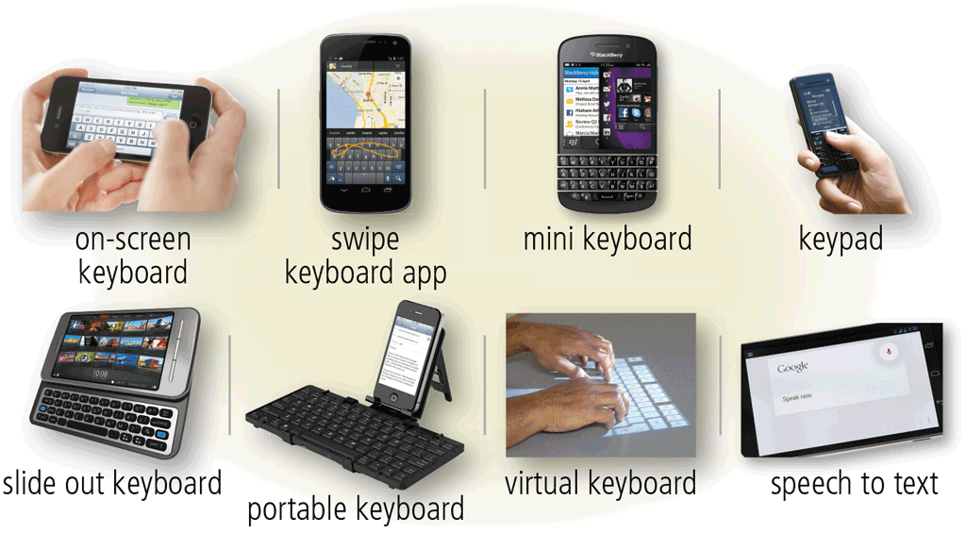
Mobile Devices
Page 123
Figure 3-15

Slide 21
Mobile Devices
Short Message Service (SMS)
Mobile to mobile
Multimedia Message Service (MMS)
Mobile to mobile
Mobile to email
Mobile to provider
Mobile to email
Page 124

Slide 22
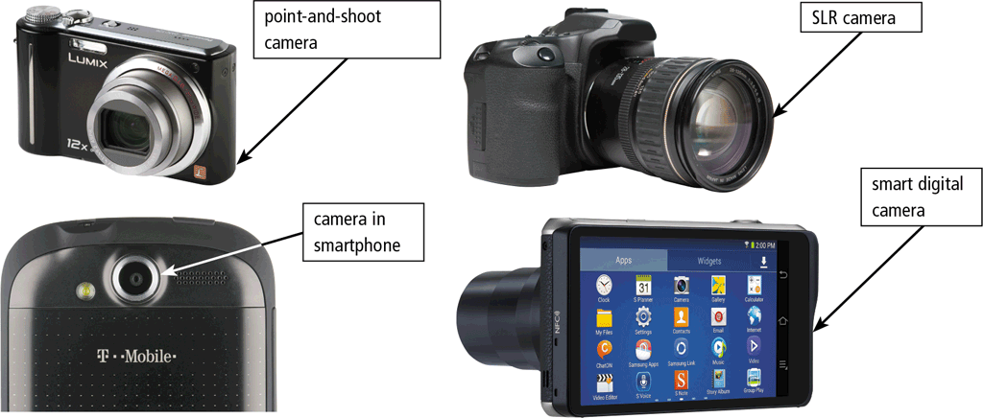
Mobile Devices
A digital camera is a mobile device that allows users to take photos and store the photographed images digitally
Smart digital camera
Point-and-shoot camera
SLR camera
Pages 125 - 126
Figure 3-16

Slide 23
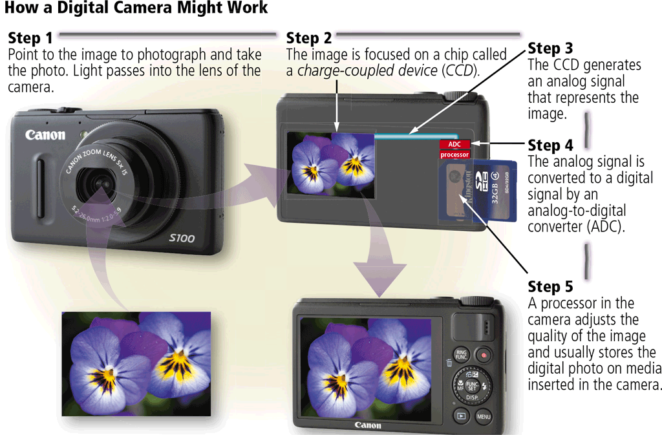
Mobile Devices
Page 126
Figure 3-17

Slide 24
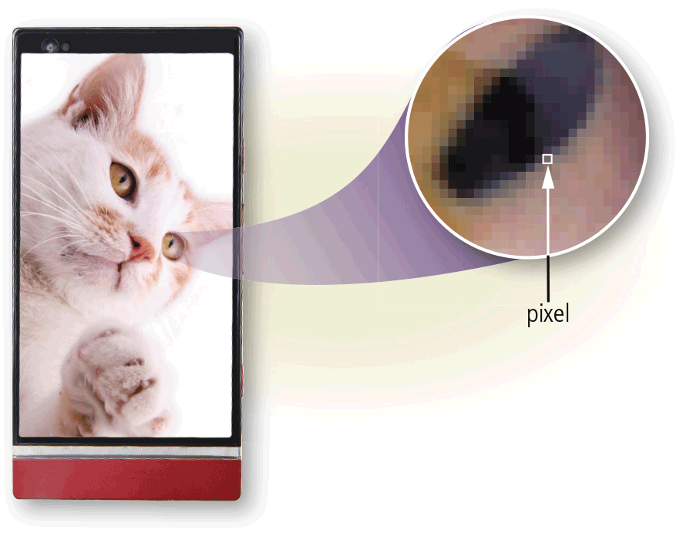
Mobile Devices
Resolution is the number of horizontal and vertical pixels in a display
Page 127
Figure 3-18

Slide 25
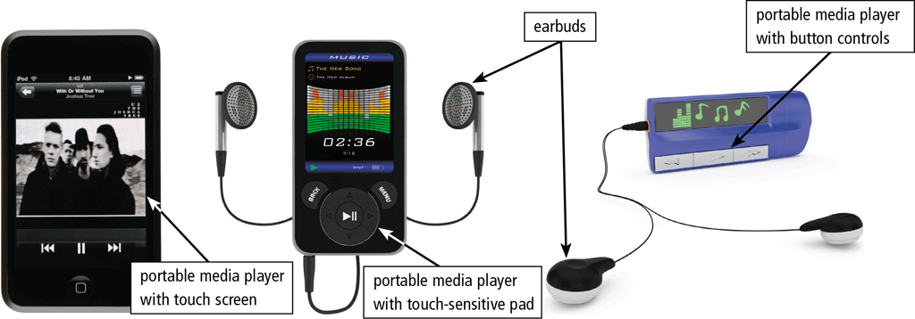
Mobile Devices
A portable media player is a mobile device on which you can store, organize, and play or view digital media
Page 127
Figure 3-19

Slide 26
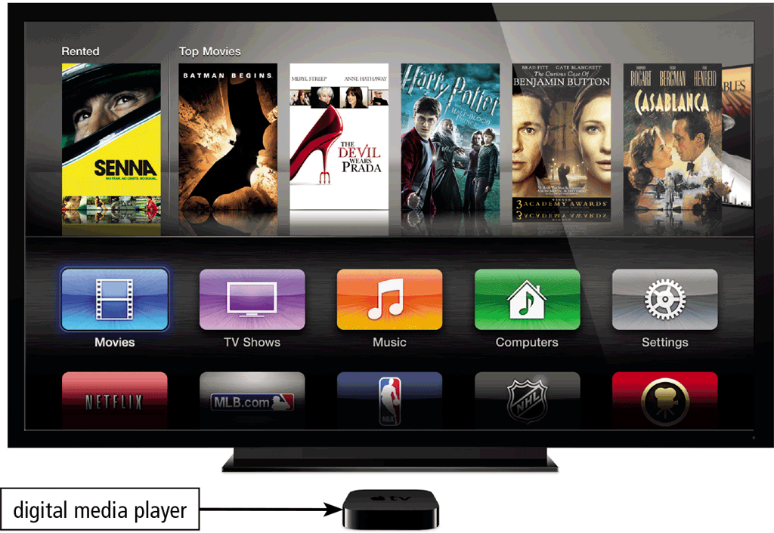
Mobile Devices
A digital media player or streaming media player is a device, typically used in a home, that streams digital media from a computer or network to a television, projector, or some other entertainment device
Page 128
Figure 3-20

Slide 27
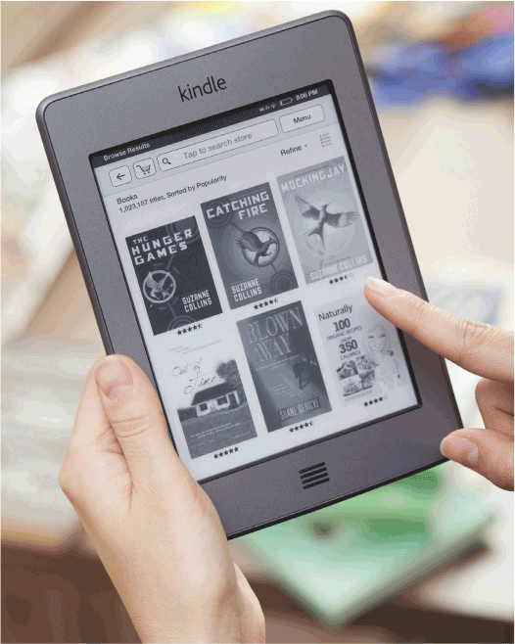
Mobile Devices
An e-book reader (short for electronic book reader), or e-reader, is a mobile device that is used primarily for reading e-books and other digital publications
Page 129
Figure 3-21

Slide 28
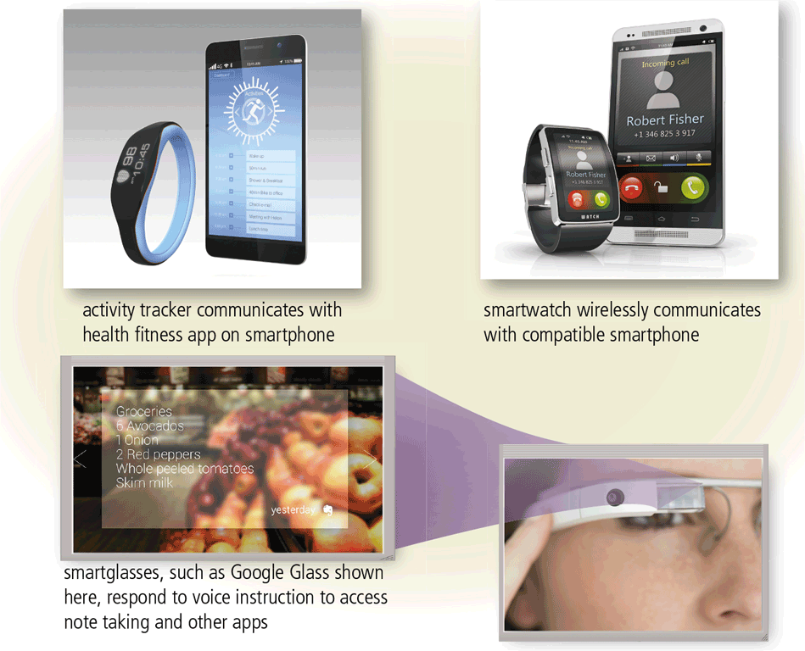
Mobile Devices
A wearable device or wearable is a small, mobile computing device designed to be worn by a consumer
Page 130
Figure 3-22

Slide 29
Game Devices
A game console is a mobile computing device designed for single-player or multiplayer video games
A handheld game device is a small mobile device that contains a screen, speakers, controls, and game console all in one unit
Game controllers include gamepads, joysticks and wheels, dance pads, and a variety of motion-sensing controllers
Page 131

Slide 30
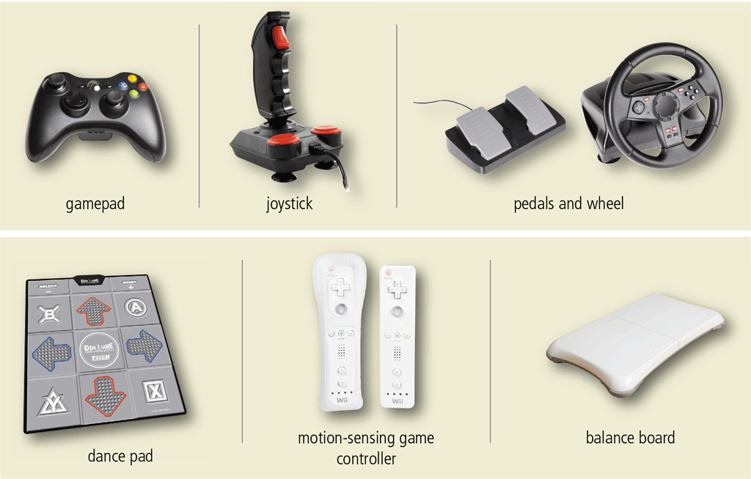
Game Devices
Page 131
Figure 3-23

Slide 31
Embedded Computers
An embedded computer is a special-purpose computer that functions as a component in a larger product
Home automation devices
Automobiles
Process controllers and robotics
Computer devices and office machines
Page 132

Slide 32
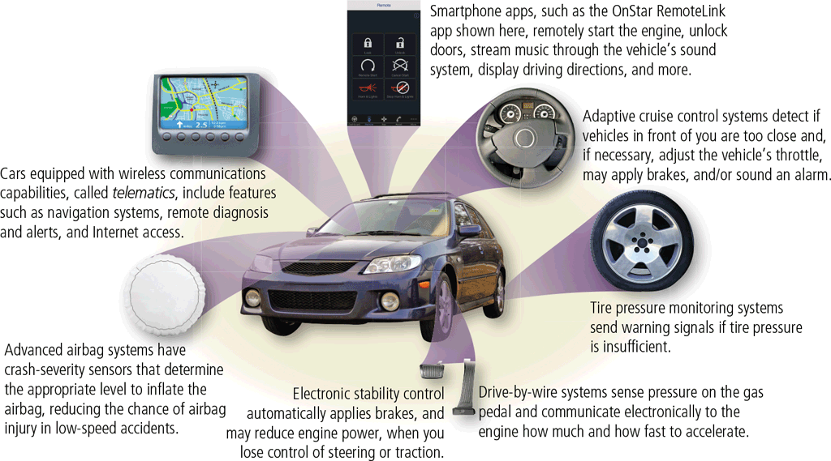
Embedded Computers
Page 133
Figure 3-24

Slide 33
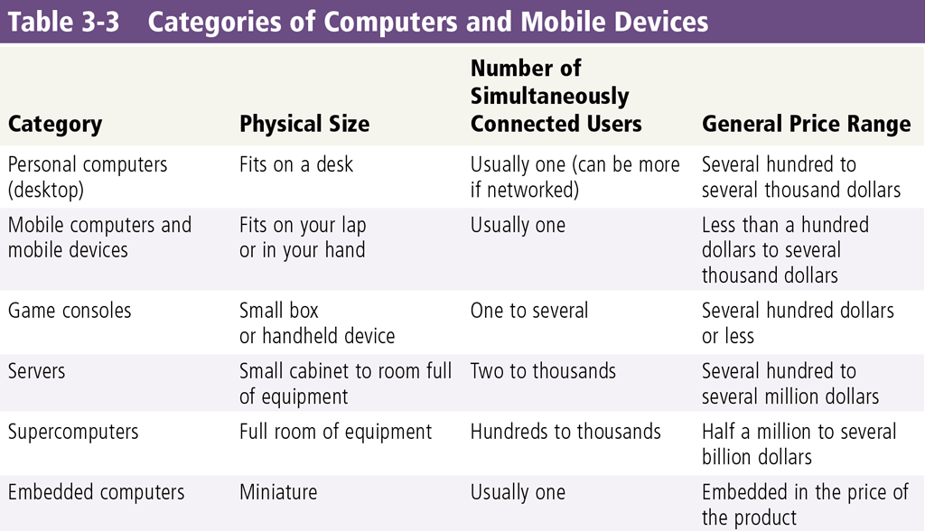
Putting It All Together
Page 134
Table 3-3

Slide 34
Protecting Hardware
Users rely on computers and mobile devices to create, store, and manage important information.
Thus, you should take measures to protect computers and devices from theft and failure.
Page 134
Table 3-3

Slide 35
Protecting Hardware
Hardware Theft and malicious destruction
Companies, schools, and other organizations that house many computers are at risk of hardware theft and malicious destruction, especially those with smaller computers that easily can fit in a backpack or briefcase.
Mobile users are susceptible to hardware theft because the size and weight of their computers and devices make them easy to steal. Thieves may target laptops of company executives so that they can use the stolen computer to access confidential company information illegally.
To help reduce the chances of theft, companies and schools use a variety of security measures.
Physical access controls, such as locked doors and windows, usually are adequate to protect the equipment.
Many businesses, schools, and some homeowners install alarm systems for additional security.
School computer labs and other facilities with a large number of semi frequent users often attach additional physical security devices, such as cables that lock the equipment to a desk, cabinet, or floor.
Mobile users sometimes lock their mobile computers temporarily to a stationary object, for example, a table in a hotel room. Small locking devices also exist that require a key to access a hard drive or optical disc drive.
Page 134
Table 3-3

Slide 36
Protecting Hardware
Hardware Failure
Hardware can fail for a variety of reasons:
such as electrical power problems; and even errors in programs or apps.
Not only could hardware failure require you to replace or repair a computer or mobile device, but it also can cause loss of software, data, and information.
Page 134
Table 3-3

Slide 37
Health Concerns of Using Technology
The widespread use of technology has led to some important user health concerns. You should be proactive and minimize your chance of risk.
Repetitive Strain Injuries
A repetitive strain injury (RSI) is an injury or disorder of the muscles, nerves, tendons, ligaments and joints. Technology-related RSIs include tendonitis and carpal tunnel syndrome.
Tendonitis is inflammation of a tendon due to repeated motion or stress on that tendon.
Carpal tunnel syndrome (CTS) is inflammation of the nerve that connects the forearm to the palm of the hand.
Page 134
Table 3-3

Slide 38
Long-term computer work can lead to tendonitis or CTS. Factors that cause these disorders
Include prolonged typing, prolonged mouse usage, or continual shifting between the mouse and the keyboard.
If untreated, these disorders can lead to permanent physical damage.

